Slide 1


Department of Management Studies E-commerce (Open Course )

Slide 2

Objective of the Course
Department of Management studies (BBA) is offering E-commerce as Open Course for the UG students of various course offered under the Calicut University.
The objectives of the course(e-commerce) are:
To understand the importance of database systems for business management.
To gain a practical orientation to database development and maintenance.

Slide 3
E-commerce
E-commerce, also known as electronic commerce or internet commerce, refers to the buying and selling of goods or services using the internet, and the transfer of money and data to execute these transactions. Ecommerce is often used to refer to the sale of physical products online, but it can also describe any kind of commercial transaction that is facilitated through the internet.

Slide 4
Why E-commerce?
From digital innovations, technological advancements, and rising globalization, the industry has witnessed quite a dramatic change amongst the many industries affected. Furthermore, with the mass adoption of the Internet in the past decade, one thing that has truly revolutionized the way companies and consumers are doing business has been e-commerce.

Slide 5
Consumers have never had as much purchasing power as now. We live in an era where people can buy almost anything at the tap of a finger, 24 hours a day, and receive their products quickly.
In this change, countless businesses have had to adapt accordingly, shifting the old way of doing things and keep up with the new speed. The more retail continues to evolve, the more ‘spoiled’ the demand of consumers become and the deeper they seek to connect with the brands they buy from.
Now, more than ever, it is less about the product alone, but more about the relationship built between the consumer and the company.

Slide 6
Syllabus Offered
Module 1
Introduction to E- commerce
E- Commerce – Impacts, Challenges & Limitations
Supply chain management
E – Commerce infrastructure
Module 2
Business models of e-commerce
E-commerce strategy
Influencing factors of successful e-commerce

Slide 7
Syllabus Offered
Module-3
Electronic Payment System
Online payment systems – prepaid and postpaid
payment systems (e- cash, e- cheque, Smart Card, Credit Card , Debit Card, Electronic purse )
Security issues on electronic payment system, solutions to security issues, biometrics (types of biometrics)
Legal and ethical issues in E- Commerce

Slide 8
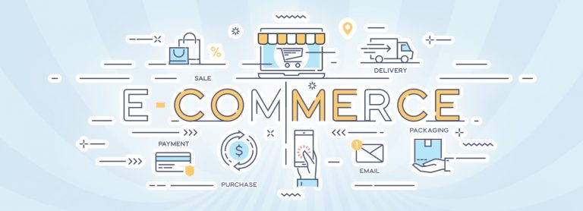
Thank You !!

